Slide 1
Reorganized and Compact DFA for Efficient Regular Expression Matching
Authors: Kai Wang, Yaxuan Qi, Yibo Xue, Jun Li
Publisher: IEEE ICC 2011
Present: Pei-Hua Huang
Date: 2014/07/07
Department of Computer Science and Information Engineering
National Cheng Kung University, Taiwan R.O.C.
Notes:
1

Slide 2
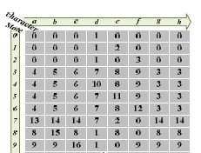
Problem Description
A DFA can be represented by a two-dimensional table ΔN*M, each element δ(φw, σκ) in ΔN*M stands for the next-state transition of state φw corresponding to input character σκ
In real-life rule sets, almost every state can share the same next-state transitions with multiple other states for most input characters

Slide 3
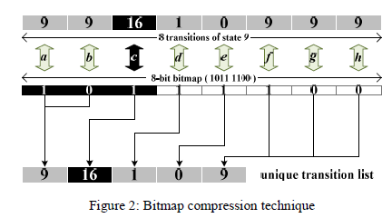
Bitmap Compression
Bitmap compression technique utilized in existing solutions to reduce the identical transitions inside each state [15]

Slide 4
Proposed method
In the real-life DFA table, identical transitions are not consecutive in most cases
To make as many identical transitions consecutive as possible, the most effective way is clustering the similar rows adjacent
we employ the bitmap technique to do compression along the state dimension, called state bitmap

Slide 5
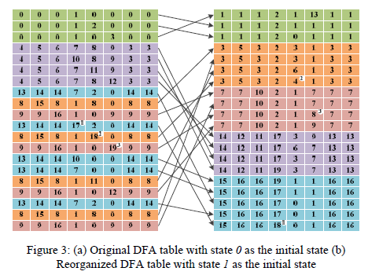

Slide 6
Compression
N-bit bitmap is introduced for state bitmap to compress the consecutively identical transitions along the state dimension efficiently
some common input characters have exactly the same original transitions along the state dimension, so the unique transition table can be compressed further by mapping them to the same character index

Slide 7
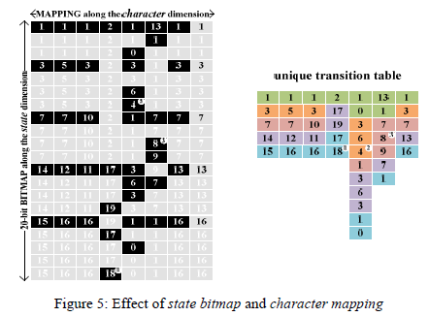
Compression

Slide 8
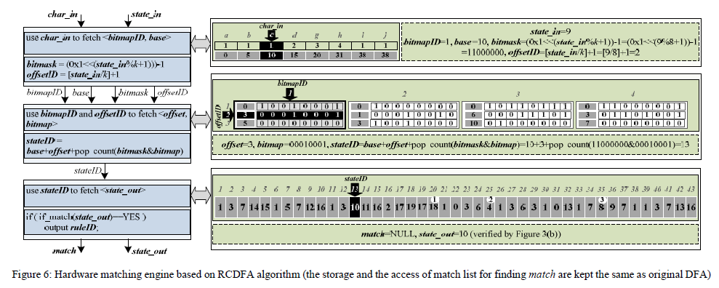
Hardware Matching Engine

Slide 9
PERFORMANCE EVALUATION
Algorithm evaluation test is based on a 2.0 GHz dual-core Intel XEON L5335 server with Ubuntu 9.04 operation system
Hardware performance test is based on a single Xilinx Virtex-6 (XC6VSX475T) FPGA platform

Slide 10
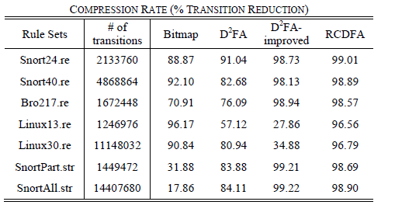
PERFORMANCE EVALUATION

Slide 11
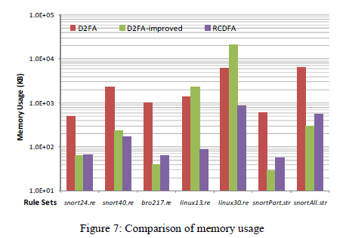
PERFORMANCE EVALUATION
Notes:
小魚1MB

Slide 12
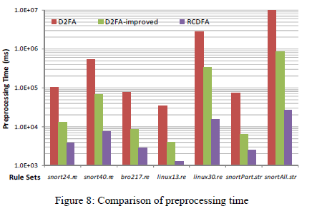
PERFORMANCE EVALUATION

